Slide 1
MGMT 6057 contemporary business management
Module 4: forms of business ownership

Slide 2
Agenda
Distribution of Businesses by Size in Canada
Factors to consider when deciding on your form of ownership
Three main forms of business ownership: sole proprietorship, partnership, corporation… plus one less common form (cooperatives)
Advantages, disadvantages of each form
Relevance for project managers and (potential) business owners
Comments about charities, non-profit organizations, mergers & acquisitions, limited liability corporations

Slide 3
Distribution of businesses in Canada by size (June 2021)
# E’es | # of Firms | %
1-4 | 748,387 | 58.0
5-9 | 233,347 | 18.1
10-19 | 152,655 | 11.8
20-49 | 99,732 | 7.7
50-99 | 32,889 | 2.5
100-199 | 14,492 | 1.1
200-499 | 7,119 | 0.6
500+ | 2,803 | 0.2
Total | 1,291,424 | 100.0
Also see this link for # of businesses without employees, that are incorporated or have more than $30000 in revenues…
Notes:
Canadian Business Counts, with employees, June 2021 (statcan.gc.ca)

Slide 4

Factors to consider when deciding form of ownership
Cost and complexity
Control
Taxes
Skills needed
Relationship with co-owners
Financing
Liability
Legacy
Notes:
Image: https://www.google.com/url?sa=i&rct=j&q=&esrc=s&source=images&cd=&cad=rja&uact=8&ved=2ahUKEwjqoNvvhJziAhVXuZ4KHdJvCLcQjRx6BAgBEAU&url=https%3A%2F%2Fwww.lucidchart.com%2Fblog%2Fwebinar-critical-elements-for-better-decision-making&psig=AOvVaw3bSa17BTh7MvOGDEnAUnUc&ust=1557958223039531

Slide 5

Sole proprietorship (one owner)
Advantages
Easy to set up
Owner has complete control
Owner gets all profits
Disadvantages
Unlimited liability
May lack skills needed
May be hard to get financing
Business ends when you leave
Notes:
Image: https://www.google.com/url?sa=i&rct=j&q=&esrc=s&source=images&cd=&cad=rja&uact=8&ved=2ahUKEwjzud2KhZziAhWS4J4KHSdFCYMQjRx6BAgBEAU&url=http%3A%2F%2Fclipart-library.com%2Fclipart%2F489747.htm&psig=AOvVaw38z5TSyTuMvf8V4Q_iDsmu&ust=1557958285138022

Slide 6
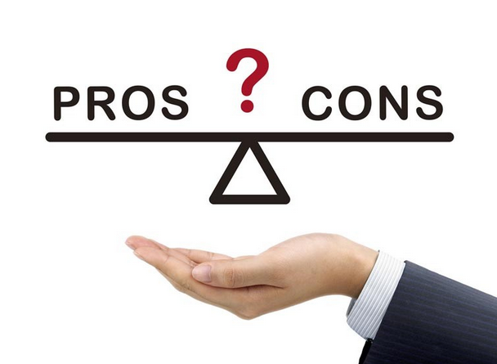
Partnership (2 or more owners)
Advantages
Partnership agreement spells out relative financial contributions/ control/ decision marking/ responsibilities
Access to more skills and financing (compared to S.P.)
Disadvantages
Unlimited liability for actions of all partners (unless you form Limited Partnership – limited partner has limited liability)
Potential personal conflicts
Share decisions and profits
“Divorce may be messy”
Notes:
Image: https://www.google.com/url?sa=i&rct=j&q=&esrc=s&source=images&cd=&cad=rja&uact=8&ved=2ahUKEwit8ryhhZziAhVGuZ4KHRK_DR4QjRx6BAgBEAU&url=https%3A%2F%2Fwww.carautocovers.com%2Fblog%2Fpros-and-cons-of-car-covers%2F&psig=AOvVaw38z5TSyTuMvf8V4Q_iDsmu&ust=1557958285138022

Slide 7
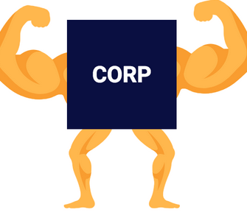
corporations
Separate legal entity from owners
Signs contracts
Can own property
Can sue or be sued
Owners are shareholders (stockholders)
Unit of ownership is called a share
Private Corporation vs Public Corporation
Who can own/purchase shares?
video (Note when watching: The process of registering a corporation in Canada is a bit different than mentioned in the video. The video mentions the “SEC” which is the regulatory organization in the United States)
Notes:
Image: https://www.google.com/url?sa=i&rct=j&q=&esrc=s&source=images&cd=&cad=rja&uact=8&ved=2ahUKEwizmpWUhpziAhVRop4KHf97CqcQjRx6BAgBEAU&url=https%3A%2F%2Fwww.corporatedirect.com%2Fstarting-a-business%2Fdifference-llcs-corporations%2F&psig=AOvVaw2E7DNwZjoA1it73GsdOWgN&ust=1557958456951977 (edit)

Slide 8



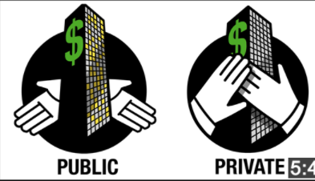

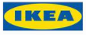
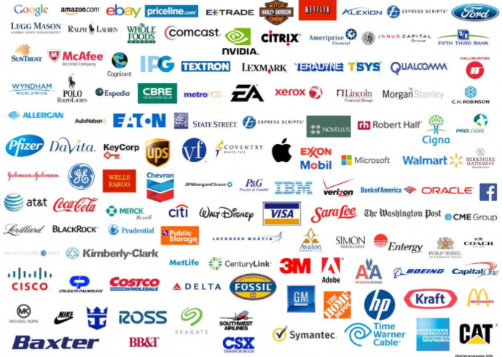

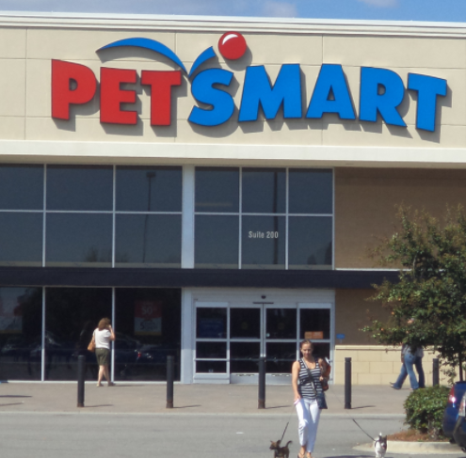
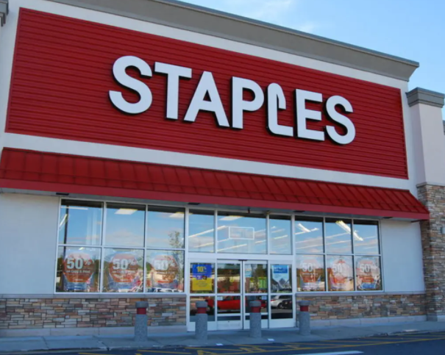
corporations

Slide 9

Corporations (cont’d)
Governance structure differs across corporations but usually consists of:
Board of Directors (elected by shareholders, headed by Chairman)
Executive management: President (in some corporations) and ‘the C-suite’
Some roles may be duplicated (e.g., person may be President & CEO, CEO & Chairman, etc.)
Notes:
Image: https://www.google.com/url?sa=i&rct=j&q=&esrc=s&source=images&cd=&cad=rja&uact=8&ved=2ahUKEwim1afshpziAhUMip4KHfRWAzIQjRx6BAgBEAU&url=http%3A%2F%2Fwww.pascackchamber.org%2Fabout%2Fmeetings%2F&psig=AOvVaw3ds1TfU6rx8VosuCRxG3HE&ust=1557958676192379

Slide 10

Corporations (cont’d)
Advantages
Limited liability
Can easily sell stock (public corp.)
Continuity
Professionally managed
Tax rates lower than other forms (also access to tax credits)
Access to financing
Disadvantages
Agency problem (conflicts of interest)
Double taxation (firm pays corporate tax, owners pay personal tax on dividends)
Harder/ costlier to form
(Video of advantages)
Notes:
Image: https://www.google.com/url?sa=i&rct=j&q=&esrc=s&source=images&cd=&cad=rja&uact=8&ved=2ahUKEwjy0PPChZziAhWVsp4KHR1hDhIQjRx6BAgBEAU&url=https%3A%2F%2Fwearelovemondays.co.uk%2Fthe-pros-and-cons-of-self-build-websites%2F&psig=AOvVaw38z5TSyTuMvf8V4Q_iDsmu&ust=1557958285138022

Slide 11

Cooperatives
Much less common than other forms
Owners are users of its service
Owners contribute resources to market products, purchase supplies, provide member services
Examples: Mountain Equipment Co-op, Ocean Spray Co-operative, agricultural co-ops, credit unions
For more information, visit Ontario Co-operative Association
Notes:
Image: https://www.google.com/url?sa=i&rct=j&q=&esrc=s&source=images&cd=&cad=rja&uact=8&ved=2ahUKEwiMlqKJh5ziAhVSu54KHZ6GDtcQjRx6BAgBEAU&url=https%3A%2F%2Fkathmandupost.ekantipur.com%2Fnews%2F2017-07-04%2Fcooperatives-and-agriculture.html&psig=AOvVaw3OhAMB8YCkpaJ7K0WWo30U&ust=1557958820070359

Slide 12

Cooperatives (cont’d)
Advantages
Membership control
Democratic
Limited liability
Profit distribution
No double-taxation (compared to corporation)
Government programs may be available
Members can join or leave without dissolving the cooperative
Disadvantages
Member conflict
Disincentive for owners to invest more
Member participation is required to make important business decisions (may be slow)
Notes:
Source: http://mycommunityfutures.ca/wp-content/uploads/2015/06/table.png,
Image: https://www.google.com/url?sa=i&rct=j&q=&esrc=s&source=images&cd=&cad=rja&uact=8&ved=2ahUKEwjz9fmhh5ziAhWIvJ4KHe-JCgQQjRx6BAgBEAU&url=https%3A%2F%2Fwww.completeconnection.ca%2F10-advantages-and-disadvantages-of-technology-in-social-media%2F&psig=AOvVaw3TsZpUtzFib9ddNa0LXFKh&ust=1557958880185406

Slide 13
Relevance for project managers and (potential) business owners
If you’d like to do freelance (independent) project-based work for external clients as a self-employed professional - or if you wish to start any type of business - you must choose the best form of ownership for you.
You need to think about issues such as control, responsibilities, and liability when making your decision.

Slide 14
Charities and non-profit organizations
Not one of the ‘forms of business ownership’
They are types of organizations that undertake many of the same functions as for-profit businesses (e.g., marketing, HR) and may be incorporated BUT:
Owners/members cannot use income for personal benefit
They have special government rules (e.g., for tax-filing, tax-exemption, incorporation, registering as a charity)
Types of charities: poverty relief, educational or religious organizations, health-related charities (e.g., Canadian Cancer Society), research or scholarship foundations, etc.
Types of non-profit organizations: amateur sports associations, business associations, etc.
Notes:
Source: https://www.canada.ca/en/revenue-agency/services/charities-giving/giving-charity-information-donors/about-registered-charities/what-difference-between-a-registered-charity-a-non-profit-organization.html

Slide 15
Mergers and acquisitions
Note: The material from this part of the textbook ‘fits’ somewhat better towards the end of the next chapter (in the section describing different ownership options). We will discuss this topic in the next Module….
Limited liability corporations
Note: Canadians cannot create limited liability corporations in Canada (they exist in the United States), so you can ignore the material about LLCs in this chapter….

